Slide 1
Big Data Analytics - Airmech case study
- Su YANG

Slide 2
Goals
Collect monetization and in-game behavior data.
Predict the likelihood a player is going to leave the game, understand why, take decisions and actions to retain players.

Slide 3
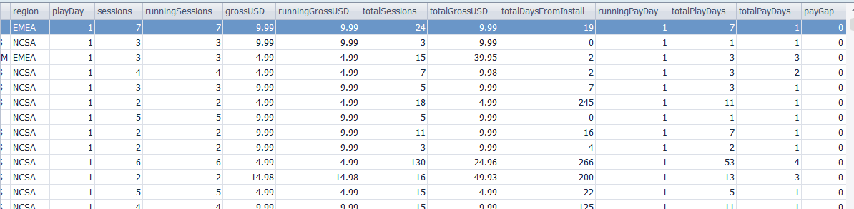
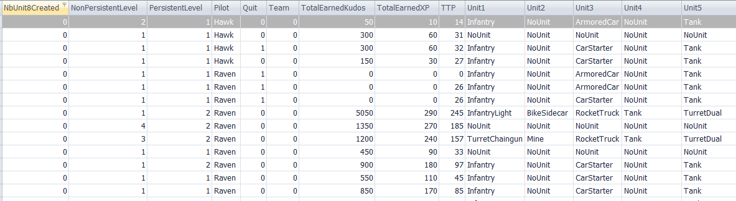
Scope of Data (only titles)
Monetization data (27 columns, 6742683 rows)
In-game behavior data (53 columns, 49203678 rows)

Slide 4
Scope of the Data
Level 3 or up (77% of all players).
Players who stops playing a week later are considered Leavers.
We train/test the algorithm on old gen data, and make predictions on the new gen data.

Slide 5
Algorithmic Parameter Selection
The 80 potential parameter don’t all influence the outcome of the algorithm, and use of non-relevant parameters will overfit the model by creating noise.
This first step needs market intelligence (via an expert) and understanding of players’ psychology.

Slide 6
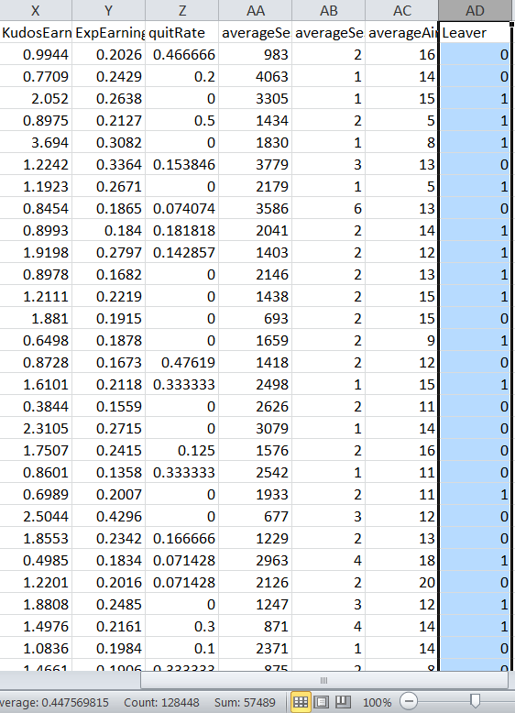
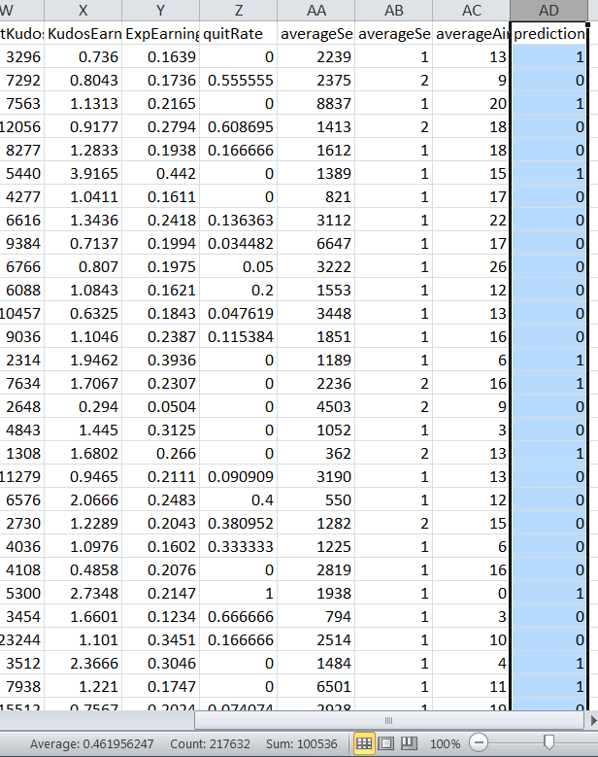
Model Validation
44.8% leavers on old gen, 46.1% predicted to be on new gen, results are consistent.
F-score = 0.68 (industry benchmark = [0.5,0.7].) -> above average.
Old
gen
New gen

Slide 7
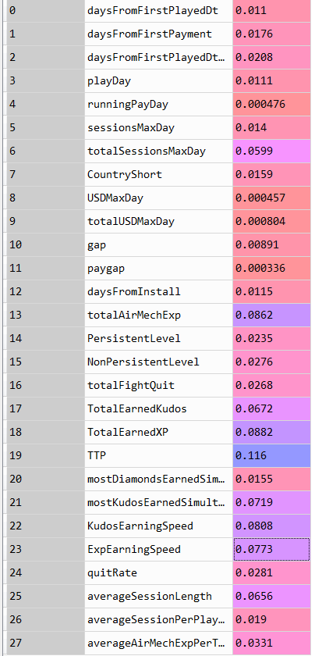
Results
Metrics used Weights on outcome
Total Time Played is the most important metric.
As a player plays less, he/she is more likely to leave soon(no surprise there).
TTP has the most influence

Slide 8
Results
Metrics used Weights on outcome
Average Session Length and Total Sessions are decent indicators of players interest, (confirmed expectations).
Drops in those metrics show interest loss, providing opportunity to re-engage player before losing them.
Sessions-related decent indicators

Slide 9
Results
Metrics used Weights on outcome
Kudos and Exp earning speed are very strong interest indicators.
Tricky : it doesn’t speak of any design inducement, but of players’ intrinsic behavior.
Player plays faster = faster Kudos/Ex gain = interests to the game. Slowing down the rhythm means they are no longer hooked. How can we change that?
3rd and 4th important indicators are speed-related

Slide 10
Results
Metrics used Weights on outcome
mostKudosEarnedSimultaneously is a surprisingly key factor.
Insight: Anchoring and Optimism Bias at play (“casino symptom”). higher reward ceilings may increase retention.
How to utilize?: -> create a crazy Wednesday with random high reward?
5th Element

Slide 11
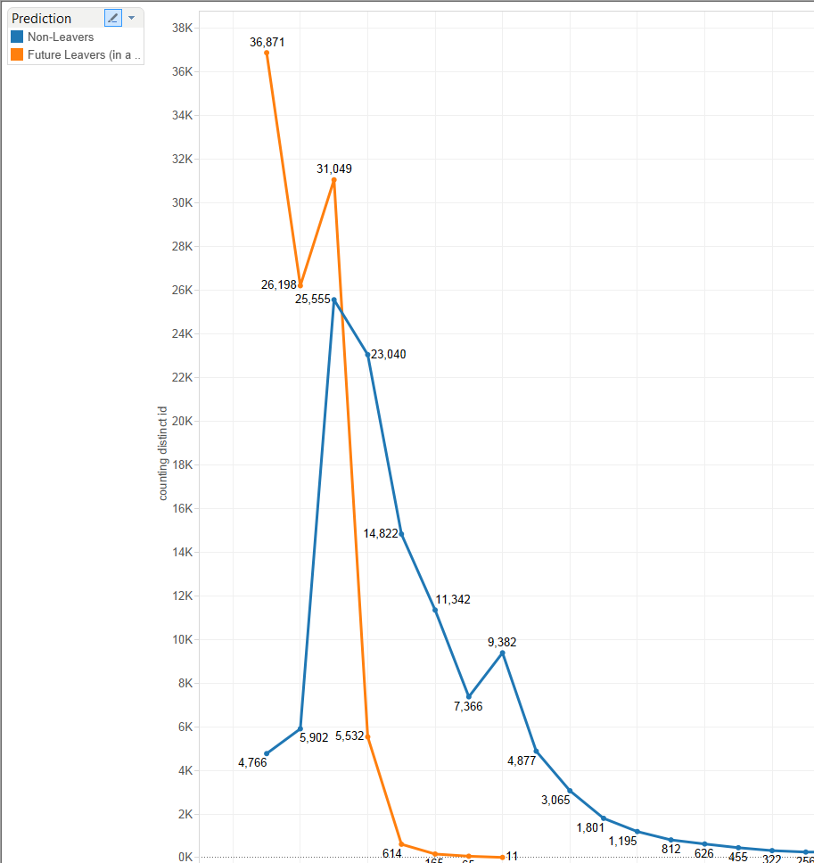
New achievement?
Pic on lv 3 (model bias) and 5 (has real value) for future leavers.
Need new achievement/ reward for better retention rate, because of the void after lv 5.

Slide 12
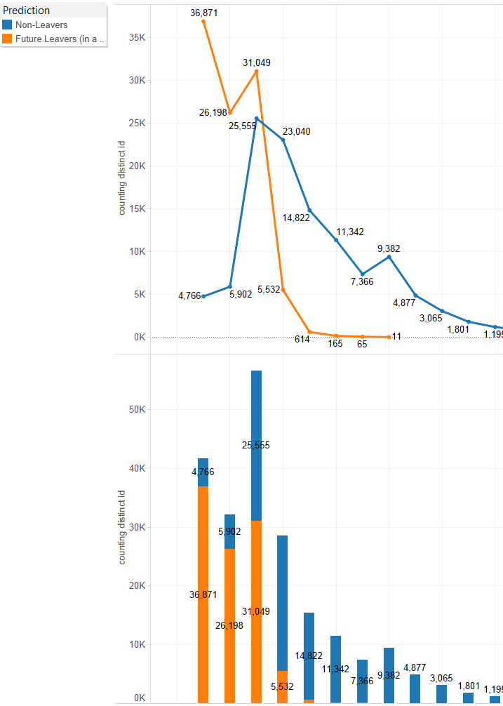
Level distribution
Among predicted leavers: 93.6% have lv 5 or less.
One more lv at lv 5: increase from 45.1% to 80.6% likelihood to keep playing <- diversify experiences?

Slide 13
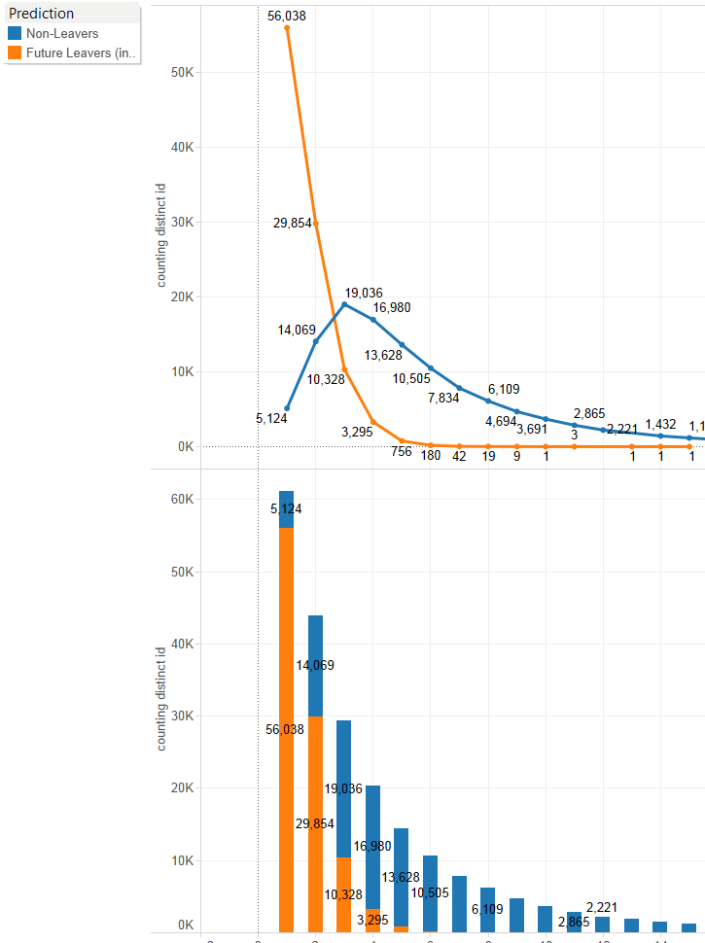
One more session?
Leavers curve is steeper than standard curve.
95.7% of leavers play 3 sessions or less (roughly 1 every 5 days). [install day]
One more session at 3 session: increase from 64.8% to 83.7% likelihood to keep playing.

Slide 14
What we really did:
Start the process with “predicting whether a player leaves” in mind.
Refine algorithm via metrics/range selection and model optimization.
Corroborate commonly accepted key metrics (TTP)
Find unexpected key metrics and understand why.
3 ways of using the outcome:
Predict player’s likelihood to quit and expected value lost.
Use relevant metrics (expected or unexpected), to track players’ interests raise red flag if need be.
Make design/marketing strategy tweaks accordingly to improve game’s attractiveness.

Slide 15
Philosophy of Data Science
Data Science is not:
Creating the perfect algorithm.
Using all available data to predict an outcome.
Data Science is:
Understanding data better.
Finding and creating relevant metrics.
Thus analyze/understand/predict players’ behavior and make deterministic measures.
All this by improving algorithm’s efficiency.

Slide 16
Conclusion
Predictive analytics != Forecasts.
Improving Machine Learning algorithm is not the end: it is means to finding patterns in players’ behavior that we can’t otherwise.
Objective: Understand players’ behavior, find relevant metrics, thus enable smarter decisions.

Slide 17
Conclusion
Big Data Analytics in video games:
Yes, it is all about Retention/Conversion.
(By understanding players’ behaviors better)

Slide 18
Appendix
As of 5/27/2015 there are 289,861 PS4, 307,749 Xone and 1,722,950 X360 players.
What takes time? (if left to one person):
Understanding data by looking at them, playing the game, talking to experts (couple of weeks)
Deciding the parameters and range, writing the fetching pipeline (SQL), prepping and learning pipeline (Python) (a few days)
Run the SQL/Python script, each iteration takes 15 minutes, and considering the number of features/players, one needs at least hundreds of iterations before anything concrete can be exploited (a few weeks).
Analyze data and find reasons by reading psychological traits, competitors’ examples' surveys (a few weeks)
In total it takes roughly 3 months one-person time to do a proper analysis on one game which cannot be scaled because every game is very different.

Slide 19
Appendix
Technical requirements:
Very strong in SQL.
Software experience in any language with external file system in order to prep the data.
Strong in Python(Scikit-learn)/R/Scala+Spark: or any language with a strong learning library.
Very strong in a data visualization software (Tableau)
Good in statistics and probabilities.
Very strong business sense (need to ask the right questions, understand the why behind the how). We want people to understand the data in the end, not the machine.
(Optional) Knowledge in sociology, psychology, physiology/neuroscience and in video games.

